Slide 1
Chapter 4
Evaluating Company Resources And Competitive Capabilities

Slide 2
Meaning of competitive advantage
Competitive advantage refers to factors that allow a company to produce goods or services better or more cheaply than its rivals. These factors allow the productive entity to generate more sales or superior margins compared to its market rivals. Competitive advantages are attributed to a variety of factors including cost structure, branding, the quality of product offerings, the distribution network, intellectual property, and customer service.

Slide 3
Competitive Advantage Areas
To build a competitive advantage, a company can use one of three main methods:
Cost: Provide offerings at the lowest price
Differentiation: Provide offerings that are superior in quality, service, or features
Specialization: Provide offerings barely personalized to a focused market

Slide 4
How to build a competitive advantage
To build a competitive advantage, a company must know what sets it apart from its competitors and then focus its message, service, and products with that difference in mind. Here are several strategies companies use to build a competitive advantage:
Research the market: Market research helps a company identify and define its target market, which can guide it in developing the most effective advantage.
Identify strengths: A company can find its unique strengths, especially relative to competitors, by reviewing products, services, features, positioning, and branding.
Evaluate finances: Companies can take a close look at their financial performance to spot profit centers and areas of stability, using financial statements and ratios.
Review operations: How efficient is a company's operations? Where is it effective and where is there room for improvement? Consider customer service as well as production and supply chain management.
Research and development (R&D): Securing intellectual property prohibits competitors from using processes or know-how that the company can use to produce products competitors can't legally copy.
Consider human resources: The talent a company can attract as employees and leadership can make an important difference in the success of the business. Evaluating company culture, hiring, and staffing practices can help.

Slide 5
What is industry analysis?
What is industry analysis? Industry analysis is the process of evaluating an industry’s current state and future outlook. It involves examining the industry’s characteristics, competition, growth trends, key success factors, and overall attractiveness to understand profit potential.

Slide 6
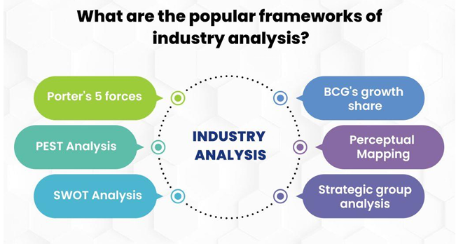
What are the popular frameworks of industry analysis?
The most commonly used frameworks of industry analysis includes Porter’s Five Forces, PEST analysis, SWOT analysis, BCG Growth-Share Matrix, perceptual mapping, and strategic group mapping.

Slide 7
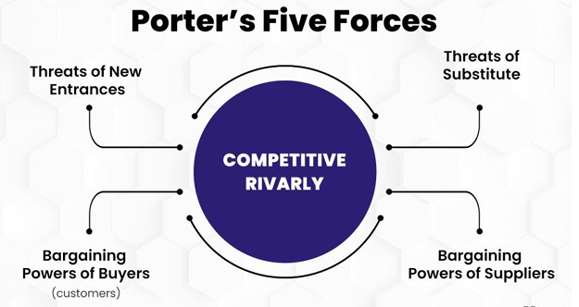
1.Porter’s five forces
Porter’s Five Forces examines the competitiveness within an industry by looking at the threat of new entrants, threat of substitutes, bargaining power of suppliers, bargaining power of buyers, and rivalry among existing competitors. It provides perspective into inherent industry profit potential shaped by competitive forces. High barriers to entry, lack of close substitute products, dispersed suppliers and buyers with low bargaining power, and minimal competitive rivalry implies higher profit potential. Intense rivalry, easy entry, potent substitutes, and concentrated suppliers/buyers suggest lower profitability.

Slide 8
2. PEST analysis
PEST analysis evaluates the external political, economic, socio-cultural, and technological environment. It identifies potential opportunities to tap into as well as threats to prepare for. Political factors include government stability, policies, regulation, and trade restrictions. Economic factors consider growth rates, interest rates, inflation, disposable income, and other macroeconomic conditions. Socio-cultural forces encompass demographics, income distribution, social norms, lifestyles, and public opinion. Technological factors look at innovations, adoption rates, R&D trends, and developments that disrupt the industry.

Slide 9
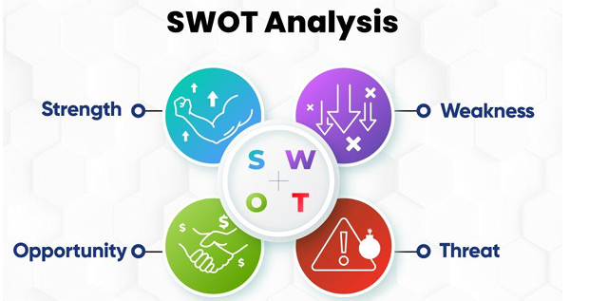
3. SWOT analysis
A SWOT analysis examines the internal strengths and weaknesses of firms in an industry along with external opportunities and threats. Strengths represent competitive advantages and distinctive capabilities. Weaknesses are deficiencies that create disadvantages. Opportunities comprise favorable external developments that are capitalized on. Threats include unfavorable industry trends and macro-environmental forces. SWOT provides perspective on internal positioning and external developments that impact strategy.

Slide 10
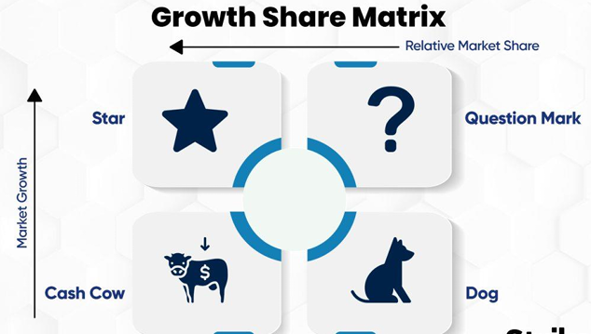
4. BCG’s growth share
The BCG Growth-Share Matrix evaluates competitive position based on market share and growth rate. Industry players are categorized as stars, cash cows, dogs, or question marks. Stars have high growth and high market share signaling opportunities. Cash cows have high share but slow growth so profits should be harvested. Dogs have low share and flat or declining growth indicating weakness. Question marks are growing rapidly but have low share implying potential if their market position is strengthened.

Slide 11
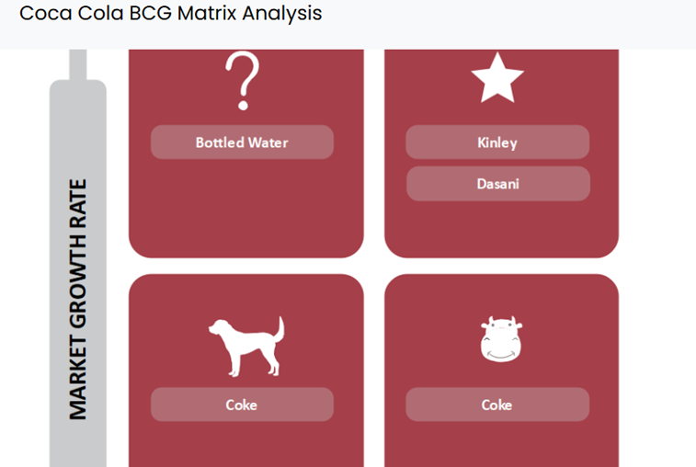
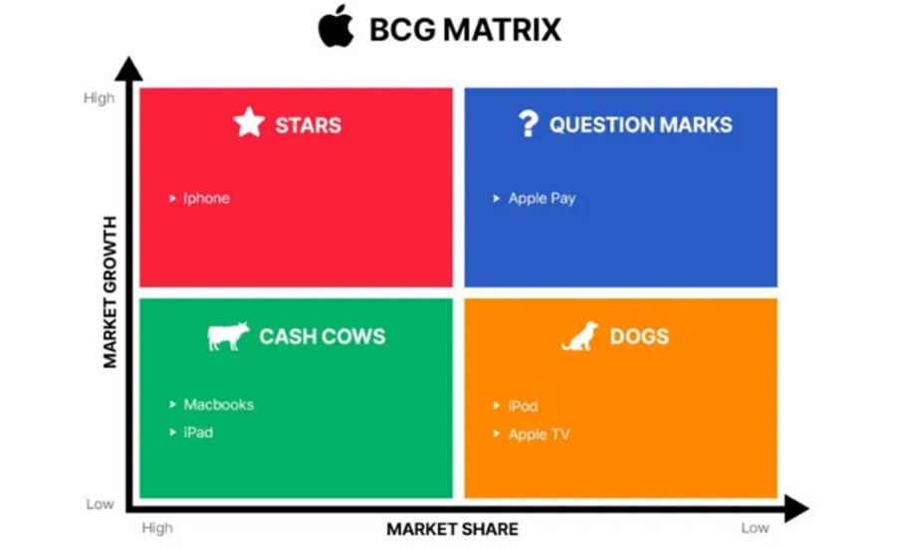
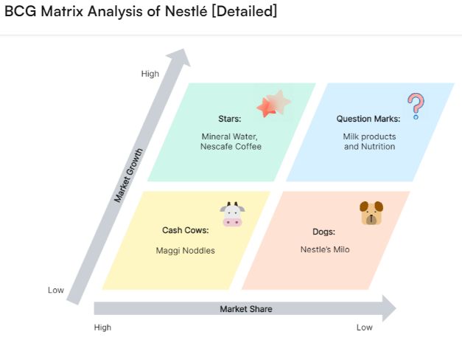

Slide 12
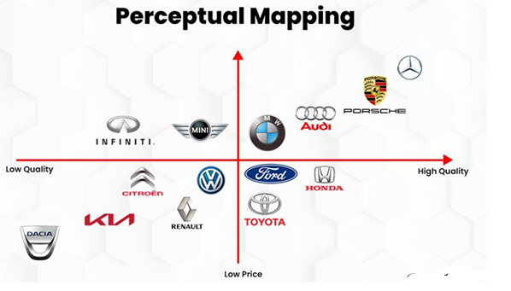
5. Perceptual mapping
Perceptual mapping displays consumer perceptions of key product attributes and preferences. Industry offerings are mapped based on attributes like price, quality, features, style, and orientation to compare positioning. Maps reveal ideal positions to target and gaps or clusters in the market. This facilitates strategic decisions on product differentiation, branding, and marketing based on consumer perceptions.

Slide 13
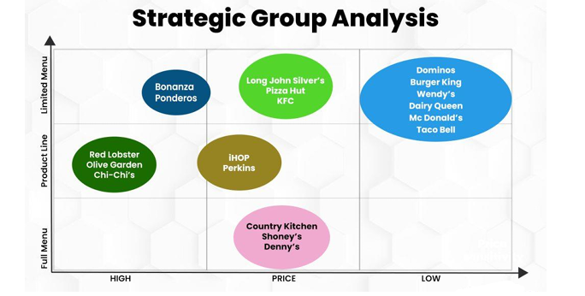
6. Strategic group analysis
Strategic group analysis divides industry players into groups based on similarities in offerings, capabilities, strategies, or other traits. Typically strategic groups reflect different competitive positions targeting certain market segments. Grouping companies reveals insights into competitive dynamics and strategic implications. Leaders want to solidify position while laggards need to reposition themselves. Applying these industry analysis frameworks leads to a comprehensive outlook to inform strategic decisions and planning.

Slide 14
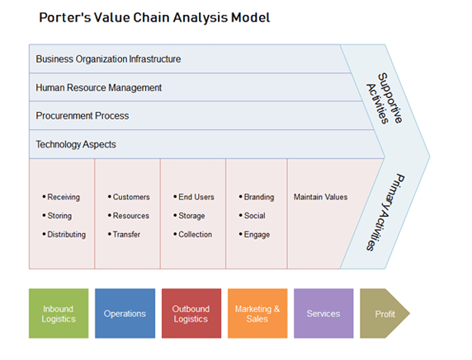
Define Value Chain Analysis:
Value chain analysis is a strategic process that can increase profit margins and provide a competitive advantage for companies of all sizes. Within this analysis, businesses identify areas where the value of specific production and sales activities can be increased.

Slide 15
What are the benefits of a value chain analysis?
• Establishes better seller management
• Reduces cost and delivery times
• Improves inventory
• Improves customer relationships
• Regulates and improves processes
• Helps you gain a competitive power

